Slide 1
ODD MAN OUT
Û
Æ
þ
Ø
SHABANA

Slide 2
DEFINITION
ODD MAN OUT
A method of selecting or eliminating a person or thing or
something from a group or sequence.

Slide 3
FIND THE ODD MAN OUT
396, 462, 572, 427, 671, 264
396
572
427
264
1

Slide 4
FIND THE ODD MAN OUT
2, 6, 15, 20, 30, 42, 56
6
15
20
42
2

Slide 5
FIND THE ODD MAN OUT
8, 7, 11, 12, 14, 18, 17, 22
11
12
14
18
3

Slide 6
FIND THE ODD MAN OUT
133, 284, 363, 441
133
284
363
441
4

Slide 7
FIND THE ODD MAN OUT
582, 605, 588, 611, 634, 617, 600
605
588
611
634
5

Slide 8
FIND THE ODD MAN OUT
10 25 45 54 60 75 85
45
25
60
NOTA
6

Slide 9
FIND THE ODD MAN OUT
Find the odd man out in the series
2 , 5 , 10 , 17, 26 , 37 , 50 , 64
50
26
37
64
7

Slide 10
FIND THE ODD MAN OUT
Find the odd one out in the given series
1254, 2364, 3816, 4640, 5361, 6813, 7490
2364
5361
7490
4640
8

Slide 11
FIND THE ODD MAN OUT
196, 169, 144, 121, 100, 82, 64
100
82
121
64
9

Slide 12
FIND THE ODD MAN OUT
114, 131, 164, 216, 284, 369
131
164
216
369
10

Slide 13
FIND THE ODD MAN OUT
ZA, RS, DE, JK, PR, LM, YZ, NO
JK
PR
LM
ZA
11

Slide 14
FIND THE ODD MAN OUT
BUY, LIE, GUY, BOY, DAM, MAD, GOD,
LOT, FAT, SPY
SPY
BOY
GOD
BUY
12

Slide 15
FIND THE ODD MAN OUT
Atto, micro, tera, pica, femto, nano
Femto
Nano
Atto
tera
13

Slide 16
FIND THE ODD MAN OUT
MK, AW, ES, JN, HP, AX, RF, LL, TD
MK
HP
AX
LL
14

Slide 17
FIND THE ODD MAN OUT
B, C, E, G, K, M, Q, S, U, W
C
Q
G
U
15

Slide 18
FIND THE ODD MAN OUT
Based on the key Word “knowledge”?
DOG, LOW, GOD, NEW, WON, OWL, GEL,
LEG, KEY
GOD
KEY
LOW
OWL
16

Slide 19
FIND THE ODD MAN OUT
Hard disk. RAM, Monitor, CPU, Windows XP
Hard disk
RAM
Monitor
Windows XP
17

Slide 20
FIND THE ODD MAN OUT
Mark the odd pair:
Nice – Good
Beautiful – Ugly
Praise – Blame
Fat – Thin
18

Slide 21
FIND THE ODD MAN OUT FROM THE CHOICE
Hyderabad
Itanagar
Patna
Mysore
Trivandrum
19

Slide 22
FIND THE ODD MAN OUT FROM THE CHOICE
India
Asia
Antarctica
Australia
Europe
20

Slide 23
Choose the alternative which does not correspond
to the given word.
Shakespeare:
Romeo
Hamlet
Novel
Play
21

Slide 24
Five statements are given below, labelled A, B, C, D and E, among these, four
statements are in logical order and form a coherent paragraph/passage. From the
given options, choose the option that does not fit into the theme of the passage.
It has now become too easy to brand anyone articulating differences with a homogenous
construct of nationalism.
The alternative progressive nationalism would entail a different understanding of India,
with the focal point being the unprivileged, and would advocate going beyond the confines of territorial nationalism.
This is because cultural nationalism — an idea that has been associated with those in
power today — basically seeks to subsume the “other” within a limiting construct of the
self and the nation.
This also explains why cultural nationalists played a peripheral and even regressive role in
the freedom struggle.
Dalits who reject Brahminical Hinduism, leftists and secular intellectuals who reject
Hindutva, beef-eaters, inter-religious couples and even dissidents who argue for freedom
from hunger, patriarchy and caste oppression, are branded as “anti-national”.
22

Slide 25
Five statements are given below, labelled A, B, C, D and E, among these, four
statements are in logical order and form a coherent paragraph/passage. From the
given options, choose the option that does not fit into the theme of the passage.
The virus is transmitted by the Aedes aegypti mosquito, which is also responsible for the
spread of dengue and chikungunya.
Chikungunya virus is a pathogen transmitted by mosquitoes, and has established itself in the Caribbean approximately 350,000 suspected cases in the Western Hemisphere since December 2013.
It stems from a huge surge in babies being born with microcephaly, a rare, incurable
condition in which their heads are abnormally small.
An obscure mosquito-borne virus, Zika, is on the prowl and has already caused an
“unprecedented situation” in the world of scientific research.
The virus gets its name from the Zika forest in Uganda, Africa, where it was first
identified in rhesus monkeys in 1947.
23

Slide 26
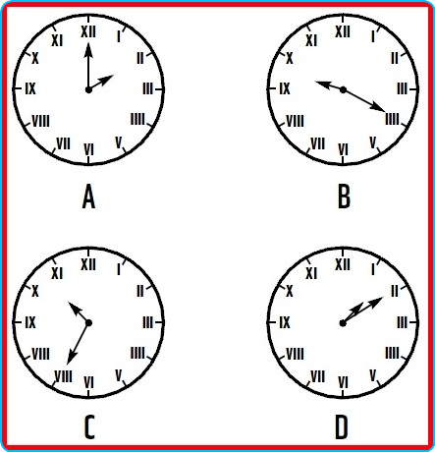
FIND THE ODD MAN OUT FROM THE CHOICE
24

Slide 27
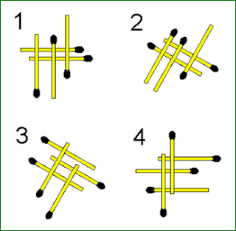
FIND THE ODD MAN OUT FROM THE CHOICE
A
B
C
D
25

Slide 28
ODD MAN OUT - KEY
1 | 2 | 3 | 4 | 5
C | B | D | C | D
6 | 7 | 8 | 9 | 10
D | D | D | B | B
11 | 12 | 13 | 14 | 15
B | A | D | C | D
16 | 17 | 18 | 19 | 20
B | D | A | D | A
21 | 22 | 23 | 24 | 25
C | B | B | C | C

